Slide 1

Operating System (CSC 3150) Tutorial 5
LeLe Li
E-mail: 221019053@link.cuhk.edu.cn

Slide 2
Content
In this tutorial, we will practice related functions for Assignment 2.
Functions you may required:
Keyboard Hit
Terminal Control
Suspend the executing thread
Hints for the game “The greatest adventurer"
Pthread conditional wait and signal

Slide 3
Keyboard Hit
In Assignment 2, we’ve provided a similar function named
int kbhit(void), you could use it directly.
int kbhit(void), If a key has been pressed then it returns a non zero value, otherwise it returns zero.
The termios general terminal interface provides an interface to asynchronous communications devices.
http://man7.org/linux/man-pages/man3/termios.3.html
http://man7.org/linux/man-pages/man2/fcntl.2.html

Slide 4
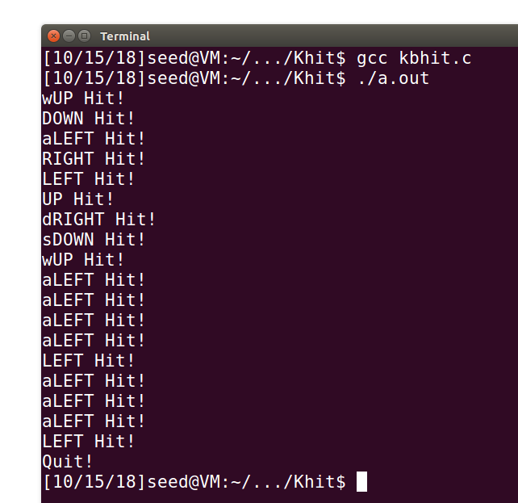
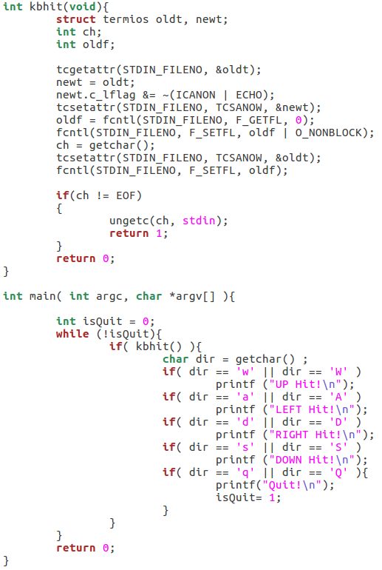
Keyboard Hit
W, A, S,D : up, left, right, down (4 directions), Q (Quit the game)

Slide 5
Keyboard Hit
int getchar(void) function is used to get/read a character from keyboard input.
int putchar(int char) function is a file handling function which is used to write a character on standard output/screen.
int puts(const char *str) writes a string to stdout up to but not including the null character. A newline character is appended to the output.
In Assignment 2, you may use above functions to complete your keyboard read and map write.
https://www.tutorialspoint.com/c_standard_library/c_function_puts.htm

Slide 6
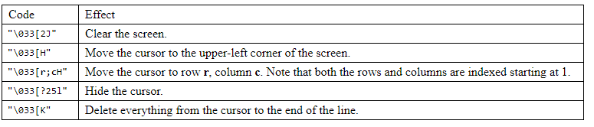
Terminal Control
When printing the message, you could use “\033” to control the cursor in terminal.
https://www.student.cs.uwaterloo.ca/~cs452/terminal.html

Slide 7
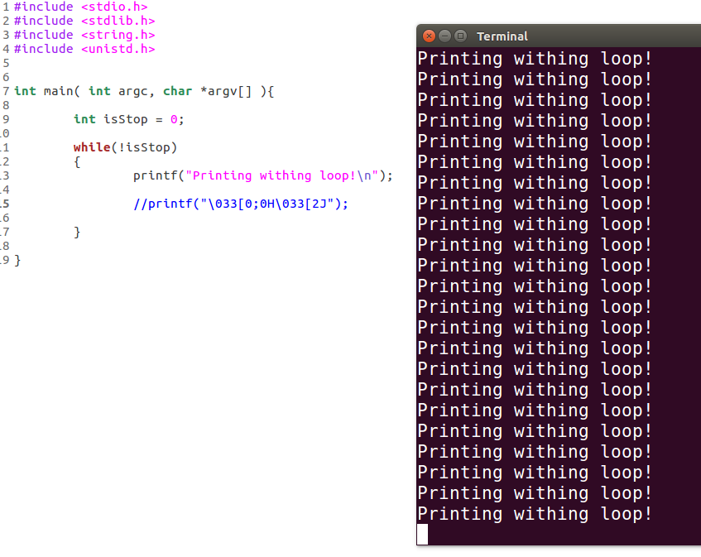
Terminal Control
Move the cursor to the upper-left corner of the screen and clear the screen

Slide 8
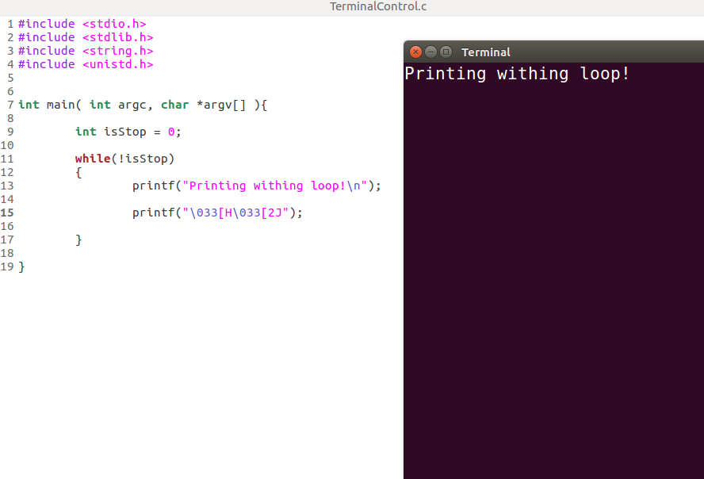
Terminal Control
Move the cursor to the upper-left corner of the screen and clear the screen

Slide 9
Suspend executing thread with three functions
int usleep(useconds_t usec) suspends execution for microsecond intervals.
The usleep() function suspends execution of the calling thread for (at least) usec microseconds.
The sleep may be lengthened slightly by any system activity or by the time spent processing the call or by the granularity of system timers.
The usleep() function returns 0 on success. On error, -1 is returned, with errno set to indicate the cause of the error.
The sleep() function accepts time in seconds while usleep() accepts in microseconds.
The nanosleep() allows the user to specify the sleep period with nanosecond precision.

Slide 10
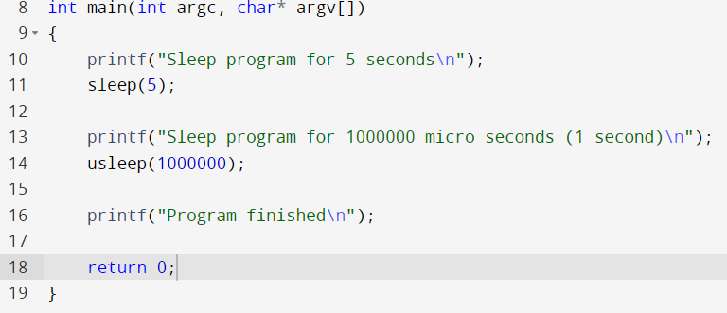
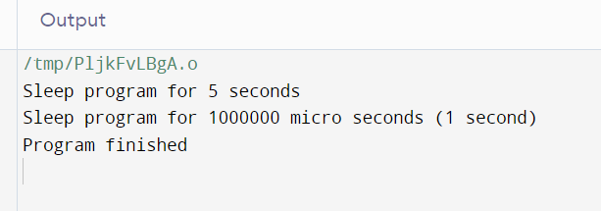

Slide 11
rand() and srand() in C
What is rand() ?
The function rand() is used to generate the pseudo random number. It returns an integer value and its range is from 0 to RAND_MAX.
Parameters
The function accepts no parameter(s) −
Return value
This function returns an integer value between 0 to RAND_MAX.
Like we want to generate a random number between 1-6 then we use this function ：
Num = rand() % 6 + 1;
What is srand()?
srand() is used to initialize random number generators. The argument is passed as a seed for generating a pseudo-random number. Whenever a different seed value is used in srand the pseudo number generator can be expected to generate different series of results the same as rand().
https://www.tutorialspoint.com/rand-and-srand-in-c-cplusplus
https://www.tutorialspoint.com/compile_c_online.php

Slide 12
Assignment 2 Hints
You must use Pthread (multithreading) to implement this assignment.
You can use khbit() to get the input character.
You can provide each object moving on your screen with a thread, and join them to realize multithreading.
You can use mutex to ensure the global variables is not modifed by multiple threads simultaneously.
You can use usleep() to control the speed of the game.
You can generate random number using rand() .

Slide 13
Pthread conditional wait and signal
Condition variables provide yet another way for threads to synchronize.
Condition variables allow threads to wait until some event or condition has occurred.
A condition variable has attributes that specify the characteristics of the condition.
Typically, a program uses the following objects:
A boolean variable, indicating whether the condition is met
A mutex to serialize the access to the boolean variable
A condition variable to wait for the condition
A condition variable is always used in conjunction with a mutex lock.

Slide 14
Pthread condition - signals
Condition variables must be declared with type: pthread_cond_t
pthread_cond_t (defined in “sys/types.h”)
Condition variables must be initialized before it is used:
int pthread_cond_init(pthread_cond_t *, const pthread_condattr_t *);
Condition variables should be freed if it is no longer used:
int pthread_cond_destroy(pthread_cond_t *);

Slide 15
Pthread condition - signals
Pthread condition routines:
int pthread_cond_wait(pthread_cond_t *, pthread_mutex_t *);
int pthread_cond_signal(pthread_cond_t *);
int pthread_cond_broadcast(pthread_cond_t *);

Slide 16
Pthread conditional wait and signal
pthread_cond_wait() blocks the calling thread until the specified condition is signaled. This routine should be called while mutex is locked, and it will automatically release the mutex while it waits.
pthread_cond_signal() routine is used to signal (or wake up) another thread which is waiting on the condition variable. It should be called after mutex is locked, and must unlock mutex in order for pthread_cond_wait() routine to complete.
Pthread_cond_wait() will automatically release the thread’s obtained mutex while pthread_cond_signal() wound not.
pthread_cond_broadcast() routine should be used instead of pthread_cond_signal() if more than one thread is in a blocking wait state.

Slide 17
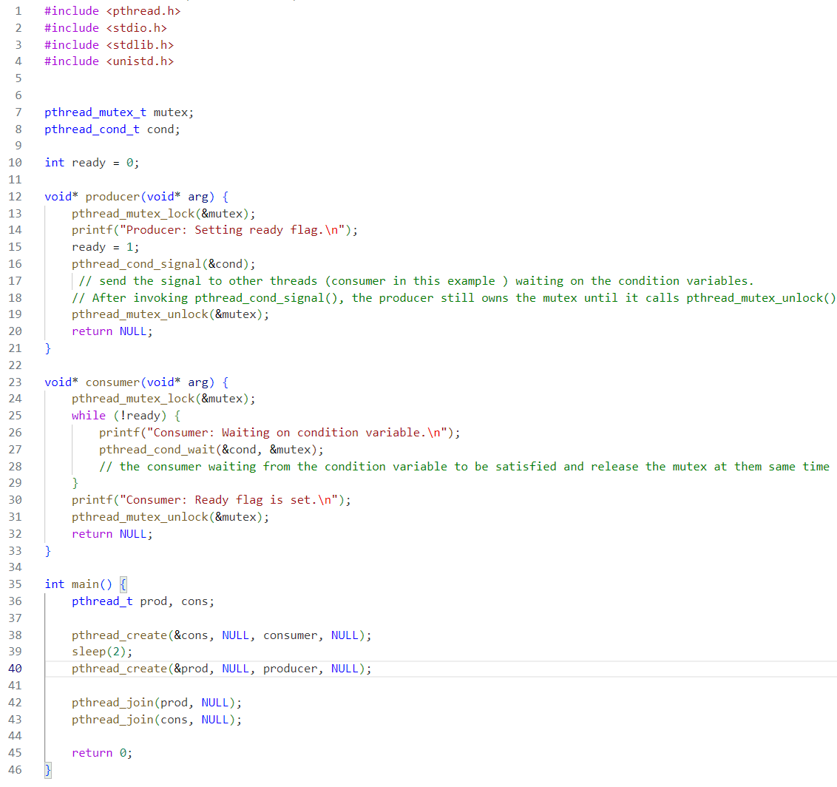
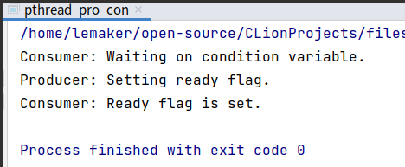
Example: One Producer and One Consumer
Output

Slide 18
References
https://www.baeldung.com/cs/async-vs-multi-threading
https://www.javatpoint.com/process-vs-thread
https://www.geeksforgeeks.org/multithreading-c-2/
https://www.geeksforgeeks.org/condition-wait-signal-multi-threading/
http://www.cs.unibo.it/~ghini/didattica/sistop/pthreads_tutorial/POSIX_Threads_Programming.htm
https://www.geeksforgeeks.org/mutex-lock-for-linux-thread-synchronization/

Slide 19
Next week’s Tutorial (Tutorial 6, Maybe Online by zoom):
Review of Pthread
Q&A (Question and Answer)
Thank you

Slide 20
Review of Tutorial 4 and Tutorial 5
What is a Thread?
A thread is a single sequence stream within a process. Because threads have some of the properties of processes, they are sometimes called lightweight processes.
What are the differences between process and thread?
Threads are not independent from each other unlike processes. As a result, threads shares with other threads their code section, data section and OS resources like open files and signals.
But, like processes, a thread has its own program counter (PC), a register set, and a stack space.
Why Multithreading? Threads are popular way to improve application through parallelism. For example, in a browser, multiple tabs can be different threads.
Threads operate faster than processes due to following reasons:
1) Thread creation is much faster.
2) Context switching between threads is much faster.
3) Threads can be terminated easily
4) Communication between threads is faster.

Slide 21
Review of Tutorial 4 and Tutorial 5
What is Pthreads?
Pthreads is a C/C++ library used to manage threads that are based on the POSIX standard.
1. Thread Management – Routines that work directly on threads - creating, detaching, joining, etc. They also include functions to set/query thread attributes (joinable, scheduling etc.)
pthread_create:
int pthread_create( pthread_t *thread,
const pthread_attr_t *attr,
void *(*start_routine) (void *),
void *arg);
Pthread termination
void pthread_exit(void *retval);
Recommendation: Use pthread_exit() to exit from all threads...especially main().
int pthread_join(pthread_t thread, void *retval);
The pthread_join() function blocks the calling thread until the specified thread terminates.

Slide 22
Review of Tutorial 4 and Tutorial 5
2. Mutexes – Mutex is an abbreviation for "mutual exclusion". Mutex variables are one of the primary means of implementing thread synchronization and for protecting shared data when multiple writes occur.
A mutex variable acts like a "lock" protecting access to a shared data resource.
pthread_mutex_t (defined in “sys/types.h”)
int pthread_mutex_init( pthread_mutex_t *mutex, const pthread_mutexattr_t *attr);
int pthread_mutex_destroy(pthread_mutex_t *);
int pthread_mutex_lock(pthread_mutex_t *mutex);
int pthread_mutex_trylock(pthread_mutex_t *mutex);
int pthread_mutex_unlock(pthread_mutex_t *mutex);

Slide 23
Review of Tutorial 4 and Tutorial 5
3. Condition variables – While mutexes implement synchronization by controlling thread access to data, condition variables allow threads to synchronize based upon the actual value of data. A condition variable is always used in conjunction with a mutex lock.
Condition variables must be declared with type: pthread_cond_t
pthread_cond_t (defined in “sys/types.h”)
Condition variables must be initialized before it is used:
int pthread_cond_init(pthread_cond_t *, const pthread_condattr_t *);
Condition variables should be freed if it is no longer used:
int pthread_cond_destroy(pthread_cond_t *);
pthread_cond_wait() blocks the calling thread until the specified condition is signalled.
The pthread_cond_signal() routine is used to signal (or wake up) another thread which is waiting on the condition variable.

Slide 24
Q&A (Question and Answer)
Thank you

